Slide 1
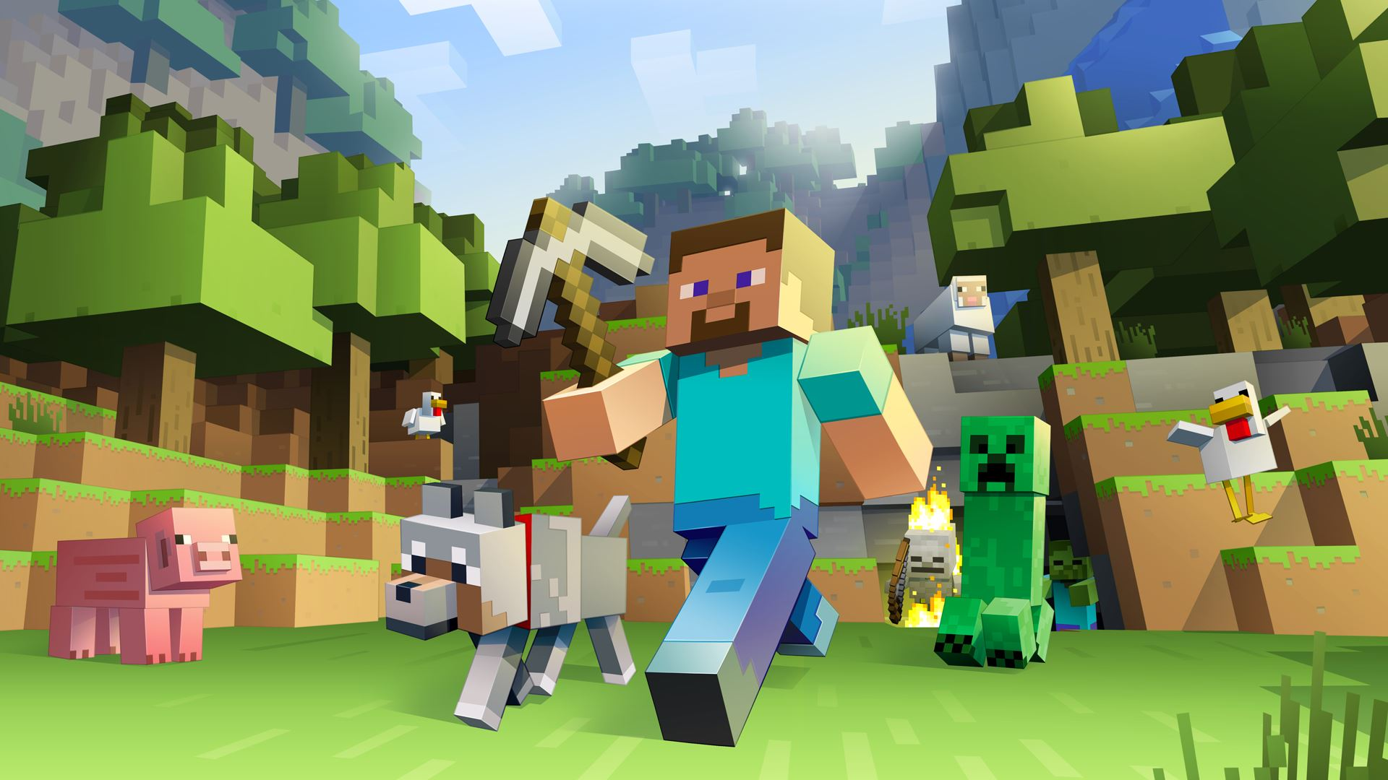
Minecraft in the classroom
Will King

Slide 2
What is Minecraft?
Game that uses digital blocks to build and create new worlds
Two modes: Creative and Survival
Mining, Crafting, Building
Collaborative – Servers
Open Architecture – Able to be Modified – Mods
Coding – Learn to Mod, Computercraft
Minecraft Edu

Slide 3
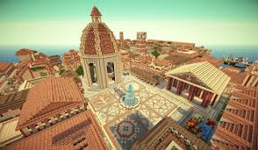
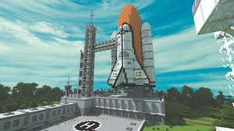
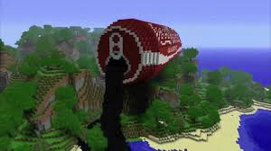

Slide 4
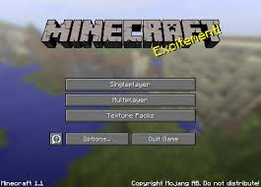

Slide 5
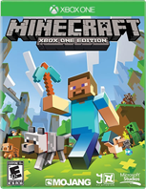
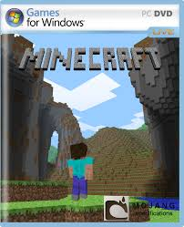
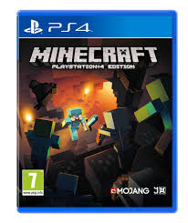
Different Platforms

Slide 6
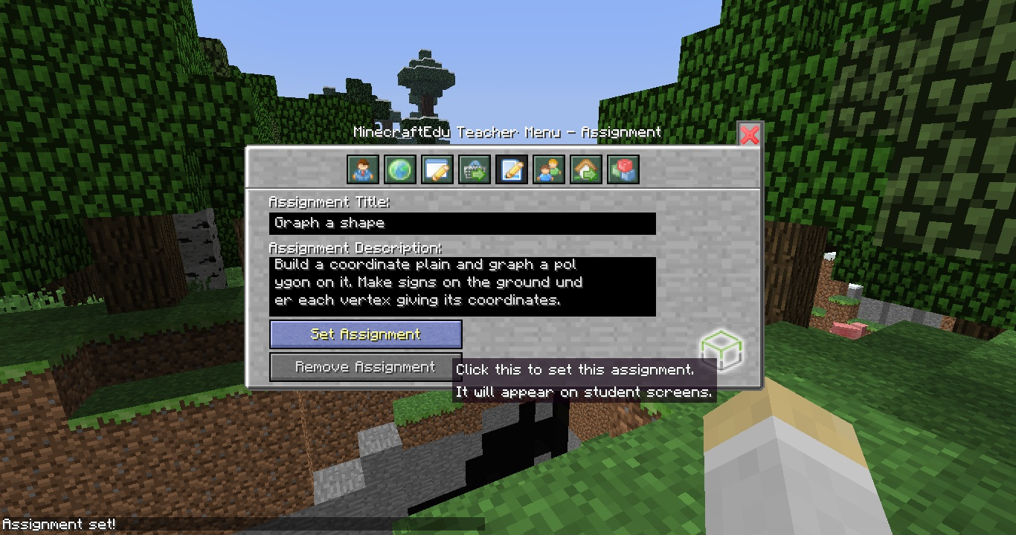
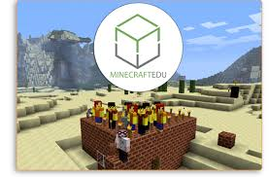
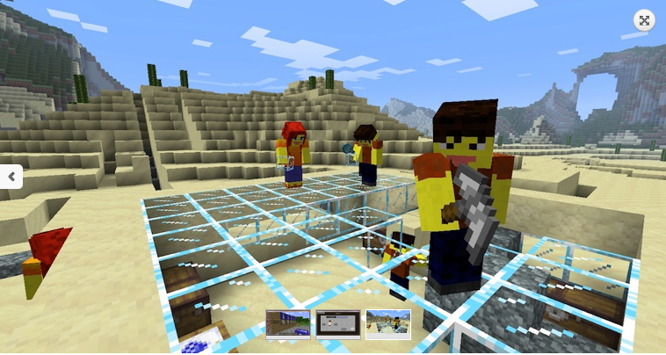

Slide 7
The Project
Year 7 SEALP SOSE
Local Indigenous History before European contact
Connect to AUSVELS
Museum of Local Indigenous History
Student directed
Leverage Digital
Inquiry based/21st century skills

Slide 8
Stage One
Solution Fluency – How would we approach the planning of this project?
Research – What does a museum floor plan look like?
Sketch out your design – must be completed before proceeding any further.
Complete Research Data Chart – select topics for exhibits

Slide 9
Stage Two – The Build
Begin building your museum in Minecraft
Using Minecraft Studio Skins – Ipad App
Difficulties with Multiplayer – phone hotspots
Limitations of Minecraft PE – Ipads
Flexible Groupings – Differentiation according to Minecraft abilities
Peer Coaching and Tutoring
Griefing on school IPads
Setting time limits on the building process

Slide 10
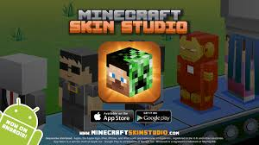
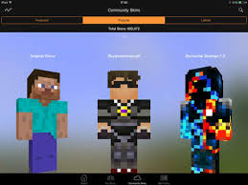

Slide 11
Stage Three - Walkthrough
Recording Minecraft walkthroughs – Bandicam
Ipads – Imovie – screenshots with voiceover
Walkthrough guide
Links to AUSVELS
Additions to Minecraft – Imovie - PicCollage
How to access the final product – upload Imovie to Youtube channel
Bandicam on USB

Slide 12
How to Assess
Students designed rubric – decided on key criteria
Equal weighting to parts of the project: Minecraft 1/3, Research/Knowledge 1/3, Skills 1/3
Assessment using Continuum rubric

Slide 13
Why Minecraft?
Engagement – Immersive experience
Leveraging existing digital skills – used outside the classroom
Deep Learning/Inquiry Learning
Student Directed
New Pedagogies
Maker Mindset/Design

